Slide 1
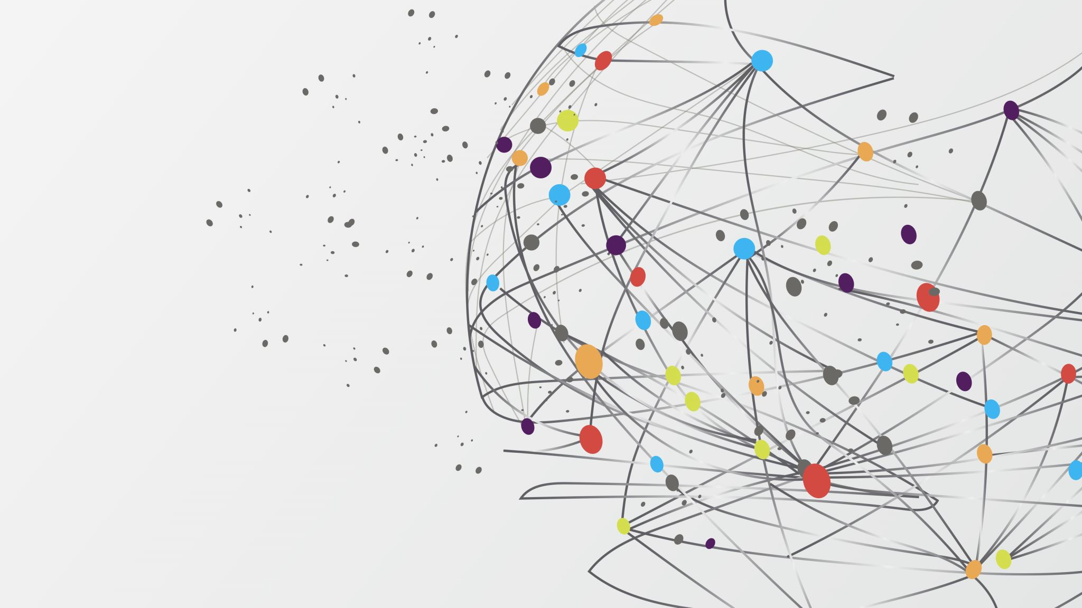
ICN-IP Coexistence Solutions
MHD Nazeer Kawas , Lisa Facciolo

Slide 2
Replacement of the existing architecture Internet Protocol (IP): - challenging task involve multiple parties coordination such ISPs.. -indefinite time to update the hardware and software, unexpected complications. -Coexistence between old and new architecture
The current Internet architecture:
- was designed for small research community 3 decades ago.
- now more than 23 billion devices , this misalignment in usage led to explore new solutions
- first issue is the availability of unique IP, another one is the type of traffic (HTTP),now 86% only video
traffic
From security aspect this design doesn’t guarantee origin auth, data integrity , data confidentiality

